Slide 1
Exploring Dev Containers + GitHub Codespaces
Lunch & Learn with Daniel Schroeder
2024
Notes:
Start Docker Desktop so it’s running
Start recording if necessary
Introduce myself
Presentation created in January 2024

Slide 2

About Dan
Individual Contributor at iQmetrix
Creating software since ~2000
Blogging since ~2010
https://blog.danskingdom.com
@deadlydog
Passions: Coding, blogging, automation, dev productivity tools
Likes: Dogs, rollerblading, staying active
Notes:
- Ensure Docker Desktop is running
- Open VS Extensions and show the Dev Containers extension and Remote Development extension pack
- Open PowerShell.tiPS project and build project and run tests
- Show PowerShell version in container vs local machine. $PSVersionTable
- Show how long it takes VS Code to start up in local vs. dev container
- Create new C# Dev Container from template
- dotnet new console
- dotnet build
- dotnet run
- Show that files only exist in the container, not on local machine
- Add ReadMe.md file with bad syntax
- Add the MarkdownLint extension to the devcontainer.json file and rebuild container
- Show that extensions can be installed without adding to devcontainer.json, but not a good idea
- Show that if you add a .devcontainer file to your project already on disk, it will exist both on disk and in container and changes show up in both

Slide 3
Overview
What are Dev Containers?
What does the code look like?
Why use them?
Demo
When to use them and limitations
Questions
What are GitHub Codespaces?
Demo
When to use them and limitations
Questions

Slide 4
Dev(elopment) Containers
Enhancing your team’s dev environment
Notes:
Poll:
How much do you know about Dev Containers?
- Never heard of them
- Heard of the term and have an idea of what they are
- Used them a few times
- I'm an expert. I only joined to make sure Dan gives accurate info

Slide 5
Dev containers are isolated, lightweight environments that provide a pre-configured development environment inside your editor or IDE. They save time by eliminating the need for manual setup and ensure a clean environment every time. Dev containers offer benefits such as pre-configured build environments, isolated environments, reproducible builds, less setup time, and flexibility in choosing base images. https://www.daytona.io/dotfiles/ultimate-guide-to-dev-containers

Slide 6
Dev Containers – What are they
Develop (write code) inside of a Docker container, rather than using your local machine’s software
Notes:
Ask who is familiar with Docker containers, and give a brief overview.
- They are like a virtual machine, except they don’t offer a GUI component; command line only.

Slide 7
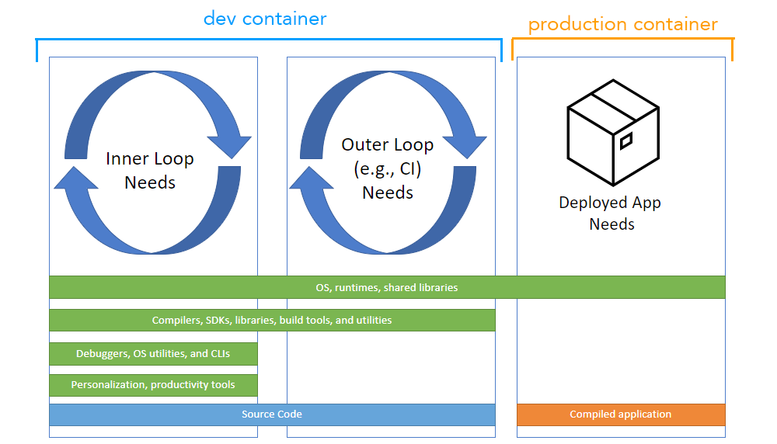
Notes:
You only use Dev Containers on your local machine, and potentially on your CI/CD system (e.g. GitHub Actions or Azure DevOps Pipelines).

Slide 8
Dev Containers – What it looks like
A DevContainer.json file that defines:
The base Docker image and features (or Dockerfile) to use
Additional commands to run when the container is created
Ports to forward to the container
VS Code extensions to install
Default settings (VS Code shell, format on save, etc.)

Slide 9
Dev Containers – What it looks like
Let’s see some code!
https://containers.dev/features
Notes:
- First show blog devcontainer with Dockerfile, then updated version without Dockerfile and using features.
- Old method with Dockerfile: https://github.com/deadlydog/deadlydog.github.io/blob/c67d189e1fb29ecf83e756e7131e999ce9b1d47b/.devcontainer/devcontainer.json

Slide 10
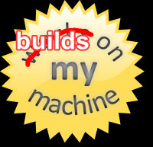
Dev Containers – Why use them
Lightweight (aside from Docker image)
Consistency (same dev experience for everyone)
Reproducibility
Portability
Stored in source control
Pre-configured, isolated build environments
Reproducible builds, less setup time

Slide 11
Dev Containers – Prerequisites
Docker (Docker Desktop for Windows)
Editor - Visual Studio Code (IntelliJ IDEA, JetBrains WebStorm)
Dev Containers VS Code extension
Or Remote Development extension pack
OR
DevContainers CLI
https://github.com/devcontainers/cli
Supported editors and tools: https://containers.dev/supporting

Slide 12
Dev Containers
Demo
Notes:
- Ensure Docker Desktop is running
- Open VS Extensions and show the Dev Containers extension and Remote Development extension pack
- Open PowerShell.tiPS project and build project and run tests
- Show PowerShell version in container vs local machine. $PSVersionTable
- Show how long it takes VS Code to start up in local vs. dev container
- Create new C# Dev Container from template
- dotnet new console
- dotnet build
- dotnet run
- Show that files only exist in the container, not on local machine
- Add ReadMe.md file with bad syntax
- Add the MarkdownLint extension to the devcontainer.json file and rebuild container
- Show that extensions can be installed without adding to devcontainer.json, but not a good idea
- Show that if you add a .devcontainer file to your project already on disk, it will exist both on disk and in container and changes show up in both

Slide 13
Dev containers are isolated, lightweight environments that provide a pre-configured development environment inside your editor or IDE. They save time by eliminating the need for manual setup and ensure a clean environment every time. Dev containers offer benefits such as pre-configured build environments, isolated environments, reproducible builds, less setup time, and flexibility in choosing base images. https://www.daytona.io/dotfiles/ultimate-guide-to-dev-containers

Slide 14
Dev Containers – When to use them
Ideally, always; In practice, when your main IDE supports it (VS Code)
Front-end web development, Node.js, …
PowerShell, Python, Bash, Ruby, Auto Hotkey, …
Terraform, Puppet, Azure CLI, …
Markdown
Linting and code formatting enforced (Editorconfig, Prettier, Spellcheck, etc.)
Shift left
Open-source software
Want to keep your local machine clean
Working with projects that depend on different SDK/runtime versions

Slide 15
Dev Containers – Downsides
Limitations
Do not support Windows containers (yet)
Not supported by many IDEs: https://containers.dev/supporting
No Visual Studio support*
https://devblogs.microsoft.com/cppblog/dev-containers-for-c-in-visual-studio/
Longer startup time, image rebuilds, disk space
Windows vs. Unix commands
Tip: Keep Dev Container dependencies in sync with CI pipeline
E.g., dotnet SDK version

Slide 16
Dev Containers – Cleanup
Docker images can eat up a lot of disk space, so remove old images
Command line (remove all images)
docker rmi $(docker images -a -q)
docker system prune –a (deletes networks and cache too)
Docker Desktop UI

Slide 17

Questions?

Slide 18
GitHub Codespaces
Write your code on the go

Slide 19
GitHub Codespaces – What is it
GitHub runs your dev container for you on their servers
Containers will persist until explicitly deleted
Connect to container from:
Web browser
Command line
Desktop app: VS Code, JetBrains, Jupyter

Slide 20
GitHub Codespaces
Demo
Notes:
- Open PowerShell.tiPS in Codespaces
- Show how to open a new Codespace, and while it gets created show how to open an existing one
- Show VS Code in GitHub vs. Codespaces
- No terminal
- Cannot build, run tests, run tasks, etc.
- No extensions
- Show you edit an existing code space (rename, change type, etc.) and then delete it
- Show creating new React Codespace from the template and running it
- Show stopping the Codespace so it does not stay running when done

Slide 21
GitHub Codespaces – Why use them
Local machine is under-resourced
Work from any device with a web browser
Do not need to clone the repo to your local machine
Pick up where you left off on another device without committing code
Try to treat them as ephemeral though
Sandbox without a repo and not on your local machine
Templates to start from - https://github.com/codespaces

Slide 22
GitHub Codespaces – Gotchas
Browser keyboard shortcuts conflict with VS Code
Ctrl + Shift + P, Ctrl + Shift + T, etc.

Slide 23
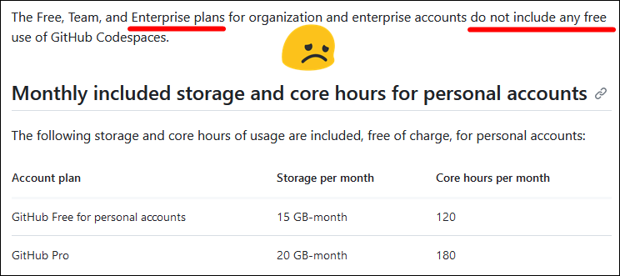
GitHub Codespaces – Cleanup
Stop your Codespaces when done with them
Defaults to stop after 30 minutes of inactivity (docs)
View your Codespaces at https://github.com/codespaces

Slide 24
Things Not Covered Here
Dev Containers
Can use docker-compose for multiple dev docker images
https://containers.dev/guide/dockerfile
Can have multiple Dev Containers defined
.devcontainer/database-dev/devcontainer.json
.devcontainer/gui-dev/devcontainer.json
How to use the Dev Container CLI without VS Code
GitHub Codespaces
Connecting to containers via command line and other IDEs

Slide 25
Questions?

Slide 26
More Information
Dev Containers
https://containers.dev
https://code.visualstudio.com/docs/devcontainers/containers
https://docs.github.com/en/codespaces/setting-up-your-project-for-codespaces/adding-a-dev-container-configuration/introduction-to-dev-containers
https://www.daytona.io/dotfiles/ultimate-guide-to-dev-containers
GitHub Codespaces
https://docs.github.com/en/codespaces/overview

Slide 27
Thank You!
Slide Deck
https://github.com/deadlydog/Presentation.DevContainersAndGitHubCodespaces
Notes:
Remind audience to fill out the follow-up survey if sending one

